Slide 1

EMPLOYEE/LEAVE MANAGEMENT SYSTEM
PREPARED BY-
UNDER GUIDANCE OF-
ADYA BHARDWAJ
PROF. PRIYANKA SAKUNDARWAR
SUPRITHA PRAKASH
PROF. AJINKYA PRABHUNE
GAUTAM KUMAR
PROF. DR. GERD MOECKEL
NANDKISHORE MAHESH
NILESH CHAVADA

Slide 2
TABLE OF CONTENTS
1. DESIGN AND THINKING
2. FLOW DIAGRAM
3. FUNCTIONALITY OF LEAVE MANAGEMENT SYSTEM
4. SIPOC DIAGRAM
5. ENTITY RELATIONSHIP DIAGRAM
6. DEMO OF APPLICATION

Slide 3
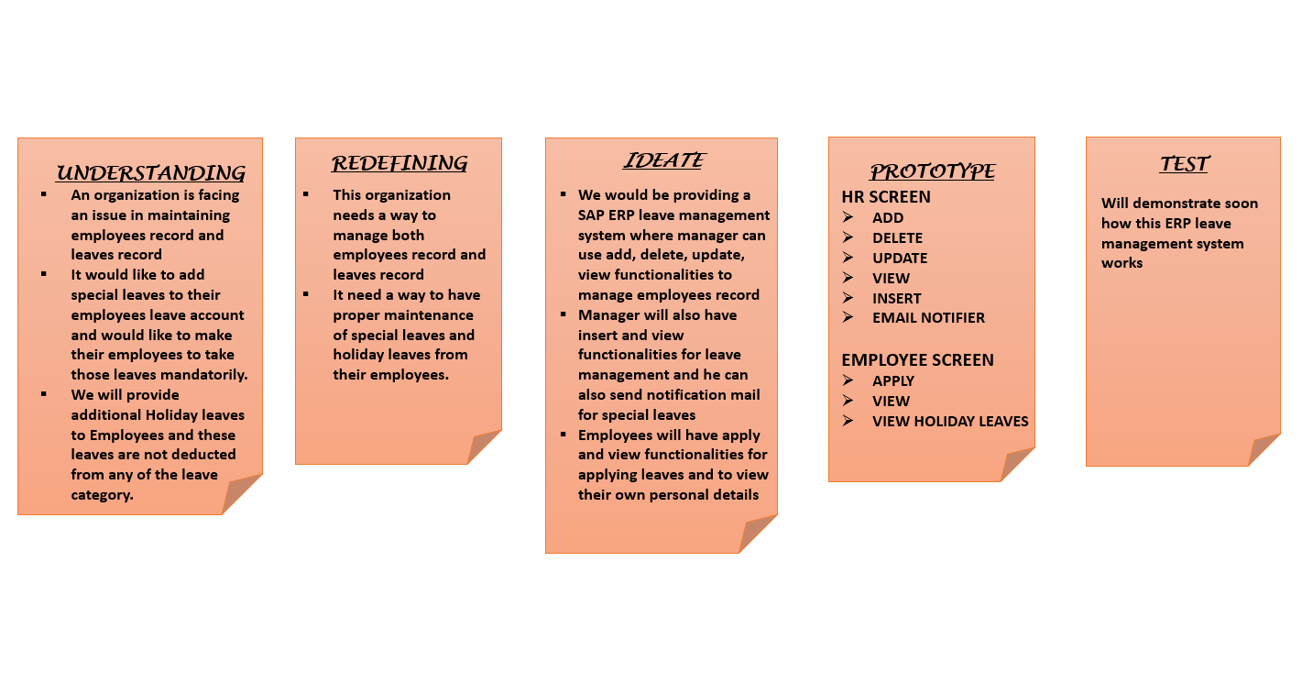
DESIGN AND THINKING PRINCIPLE

Slide 4
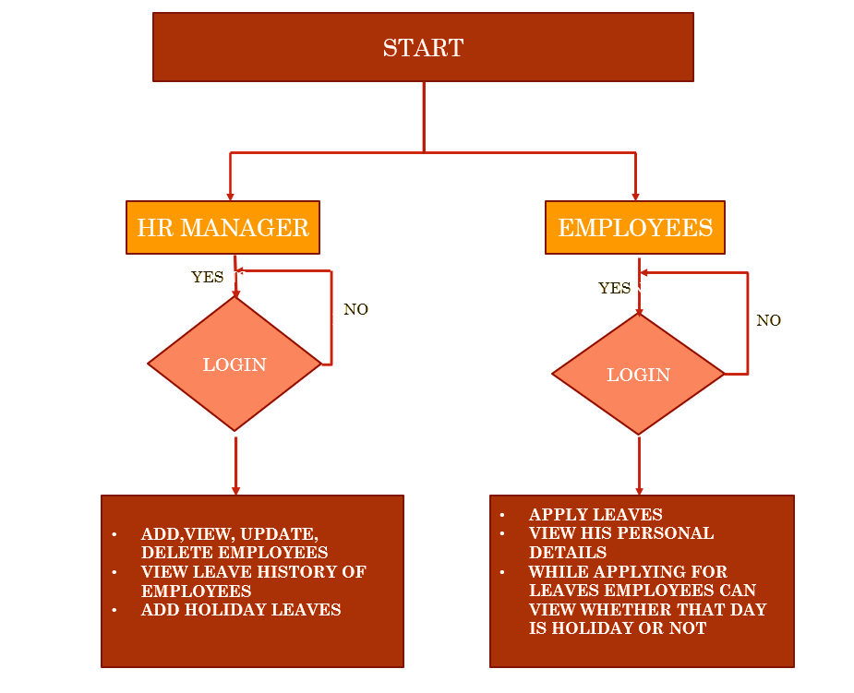
FLOW DIAGRAM

Slide 5
FUNCTIONALITY OF LEAVE MANAGEMENT SYSTEM
In our project Leave management system the HR Manager will have the privilege to Add, View, Update and Delete the record of employees as well as in addition will also have the rights to View the Leave History of the employees (Earned leaves, Casual leaves, Sick leaves and Special leaves ).
In this the employees will apply for the leave and the leaves will be deducted from the leaves details table.
Category of Leaves
Earned Leaves :- There is category called Earned Leaves in our project. Total 10 leaves would be allotted in this category.
On every new year first day, there is an automated system/program that will check earned leaves if any left with the employees in the previous year then those leaves will carry forward in the next year and corresponding database for that Employee would be updated along with updation of Total leaves as well.

Slide 6
Casual Leaves :- These leaves are also 10 in number and are granted for certain unforeseen situation and it is taken when we need to take leaves for one or two days, and if the leaves are not taken by the employees till the end of year then it collapsed and it can’t be carry forward in the next year.
Sick Leaves :- These leaves are provided to the employees if there are not feeling well. Employee will have total 10 leaves per year and if the leaves are left in the end of year then it will be collapsed.
Special Leaves :- These leaves are provided to the employees for 14 days per year . Only one time employees can take these leaves. In our project we have a functionality as in where the project manger can view and extract all the employees those who have taken the special leaves as well as the manager will have the privilege to send an email to the employees those who have not taken the leaves. These leaves are highly recommended to the employees and if not taken the manager can send notification to the employees otherwise these leaves would also be collapsed automatically.
Holiday Leaves :- These leaves are provided to the Employees for National Holidays. When the employee will apply for the leaves on the same day of Holidays leaves then these leaves are not deducted from the Casual Leaves ,Sick Leaves and Earned Leaves.

Slide 7
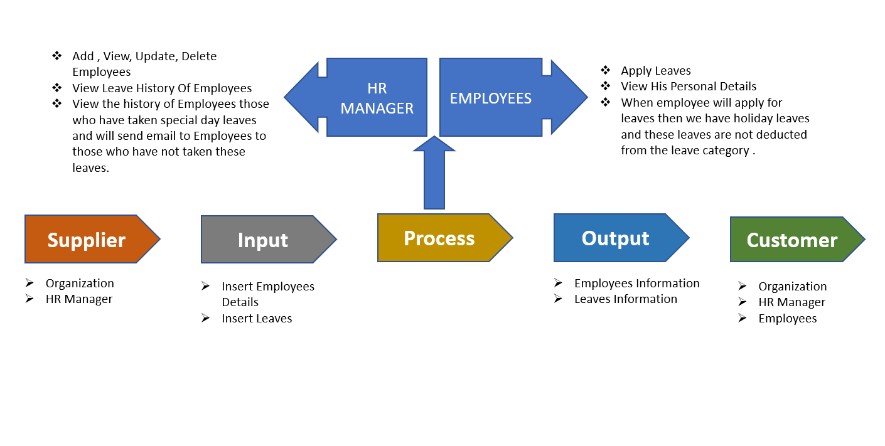

SIPOC DIAGRAM

Slide 8
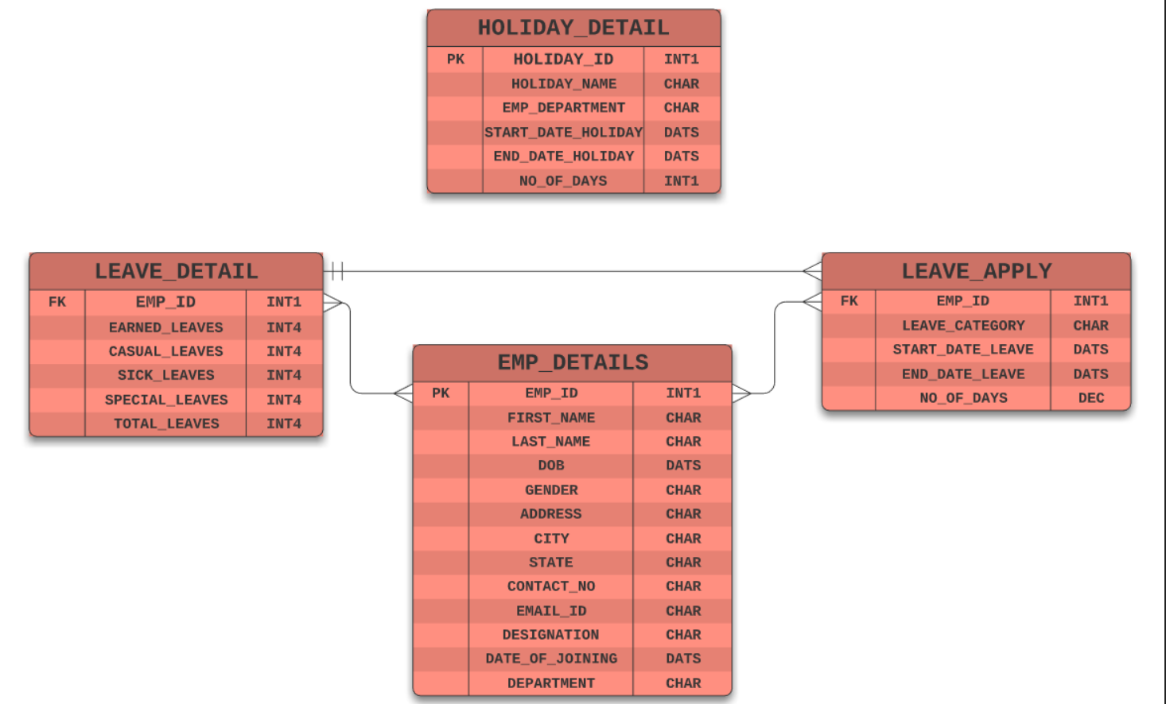
ENTITY AND RELATIONSHIP DIAGRAM

Slide 9
LET’S GO TO PRACTICAL PART

Slide 10
THANK YOU PROFESSOR

